Slide 1
Projected Year End numbers based on current trends – OCT-DEC
EXP: +102K
REV: +131K
Expenses over the last fifteen years have increased a total of 99% / 6.6% annually
Revenues over the last fifteen years have increased a total of 52% / 3.5% annually
Expenses have increase significantly in the last three years 23-25 (26%) and revenue have not maintained pace.

Slide 2
2025 projected closing balance is 100K – Down from approximately 250K to close out 2024

Slide 3
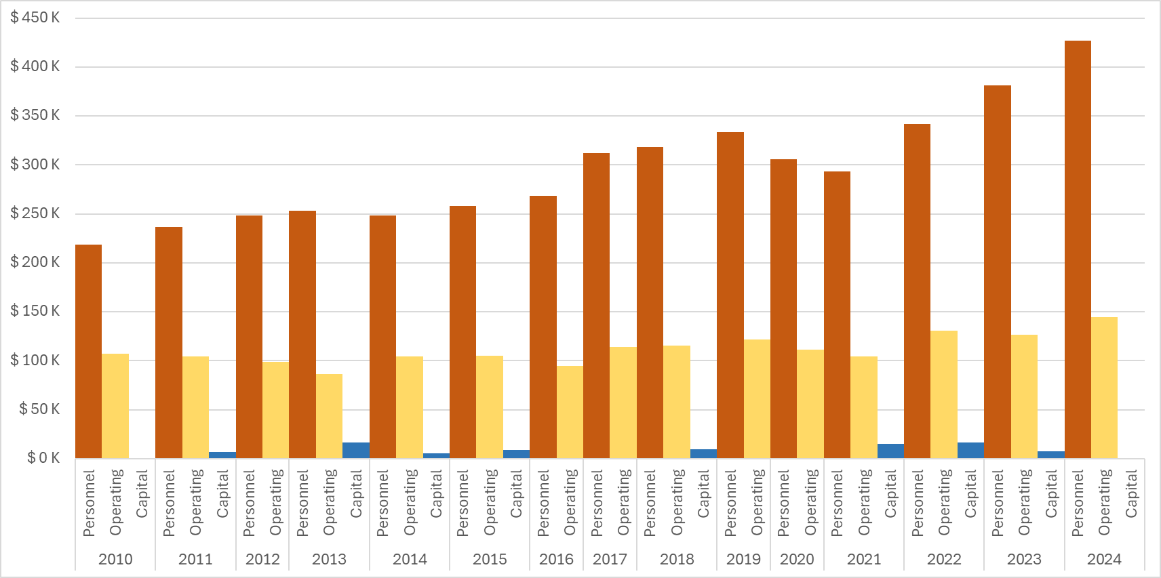
Expenses by Category – Excludes 2025 incomplete data set

